Slide 1
Places to Go in Philadelphia
By Franky Delphia

Slide 2
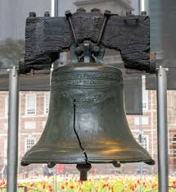
Liberty Bell Center
The Liberty Bell is one Philly’s most iconic sites
You can’t visit without seeing a vital piece of US history

Slide 3
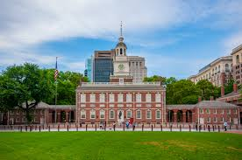
Independence Hall
Get transported back to the times of our founding fathers and stand where they once stood

Slide 4
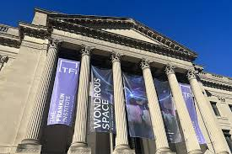
Franklin Institute
Great for all ages especially the younger generation
Find exhibits ranging from the “Art of the Brick” and even Disney displays

Slide 5
Book a Trip Today!

